Slide 1
Stroke Prediction In Patients

Slide 2

Goal

Slide 3
Predicts whether a person is at risk of having a stroke or not

Slide 4

Who benefits from the project?

Slide 5
Patients and healthcare workers

Slide 6

Data Source

Slide 7
Source:
Kaggle
Contains:
5110 Records
12 Features

Slide 8

Explore Data Set

Slide 9

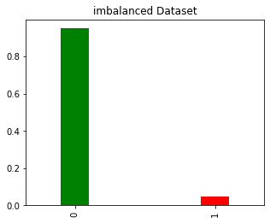

Slide 10
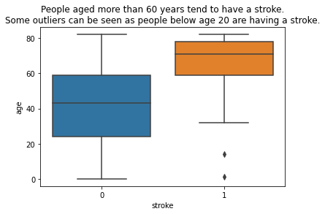

Slide 11
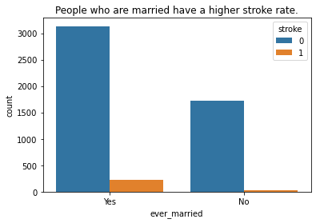

Slide 12
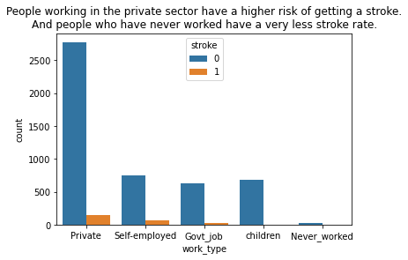

Slide 13
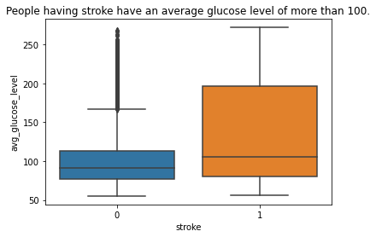

Slide 14
Handling Data Set

Slide 15
Handling Missing Values:
201 from [bmi]
Use (KNNImputer)

Slide 16
Handling Columns:
Gender&work_type& Residence_type& smoking_status& ever_married.

Slide 17
Handling Class Imbalance:
Using over_sampling(SMOTE)

Slide 18
Models & Performance

Slide 19
Classification Algorithm

Slide 20
Before Handling Imbalance
After Handling Imbalance

Slide 21
Thank you for listening

Slide 22

Any questions

